Slide 1
Starbucks Menu Analysis
An Analysis of Calories and Macronutrients for the Technical Audience
Presented by : Angela Mercy Sebasthiyan

Slide 2
Introduction
This analysis explores the Starbucks menu data focusing on calories and macronutrients (fat, carbs, fiber, protein). The goal is to uncover trends, correlations, and patterns that can help us better understand the nutritional profile of the menu items.
Starbucks Menu – Data:
https://docs.google.com/spreadsheets/d/1N0bTtBJpFG2-b77w37KX6D9OSDTSaOyV/edit?usp=sharing&ouid=101478551021008593450&rtpof=true&sd=true

Slide 3
Key Questions
1. What are the highest and lowest calorie items?
2. Are there correlations between calories and macronutrients which are fat, carbs, protein?
3. What trends can we observe between macronutrients?
4. How do macronutrient levels impact the calorie content?

Slide 4
Here, I used .corr() method from python to correlation matrix. The .corr() method calculates the correlation matrix for the columns. The correlation matrix shows the pairwise correlation coefficients between numerical variables in the dataset. It helps to understand which variables are positively or negatively related.
To Calculate correlation matrix:
correlation_matrix = data_selected.corr()
print(correlation_matrix)
Correlation Matrix:
 | Calories | Fat (g) | Carb. (g) | Fiber (g) | Protein (g)
Calories | 1 | 0.828929 | 0.708496 | 0.471079 | 0.618962
Fat (g) | 0.828929 | 1 | 0.281132 | 0.276059 | 0.423364
Carb. (g) | 0.708496 | 0.281132 | 1 | 0.407655 | 0.204375
Fiber (g) | 0.471079 | 0.276059 | 0.407655 | 1 | 0.472246
Protein (g) | 0.618962 | 0.423364 | 0.204375 | 0.472246 | 1

Slide 5
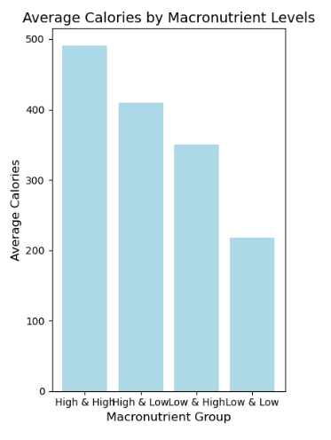
Comparison of Average Calories level in Macronutrient Groups
The histogram visualizes the average calories in all four different macronutrient groups.
Each group represents high and low levels of macronutrients like carbohydrates, proteins, or fats.

Slide 6
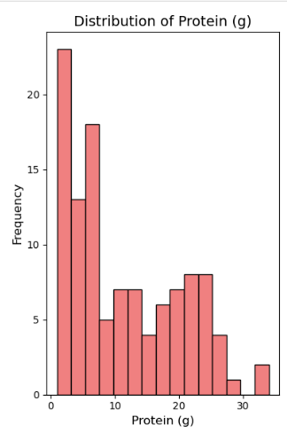
Distribution of Protein Content in Food Items
This histogram represents the distribution of protein content (in grams) across a dataset.

Slide 7
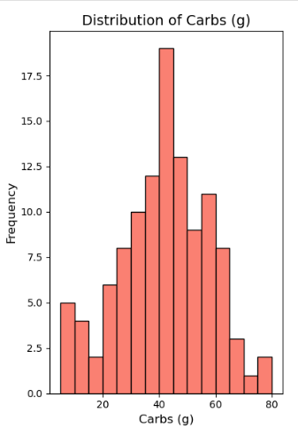
Distribution of Carbohydrate Content in Food Items
This histogram shows the distribution of carbohydrate content (in grams) across a dataset.

Slide 8
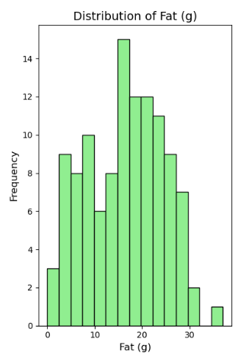
Distribution of Fat Content in Food Items
This histogram shows the distribution of fat content (in grams) across a dataset.

Slide 9
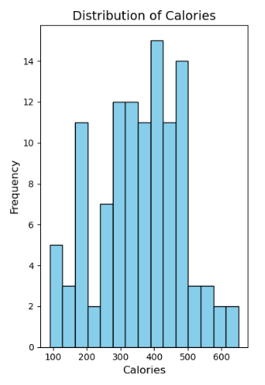
Distribution of Calorie Content in Food Items
This histogram visualizes the distribution of calories across a dataset.
Fewer items are observed in the lower calorie range 100–200 and at the higher calorie range above 500.
This indicates that most items fall within a moderate calorie range.

Slide 10
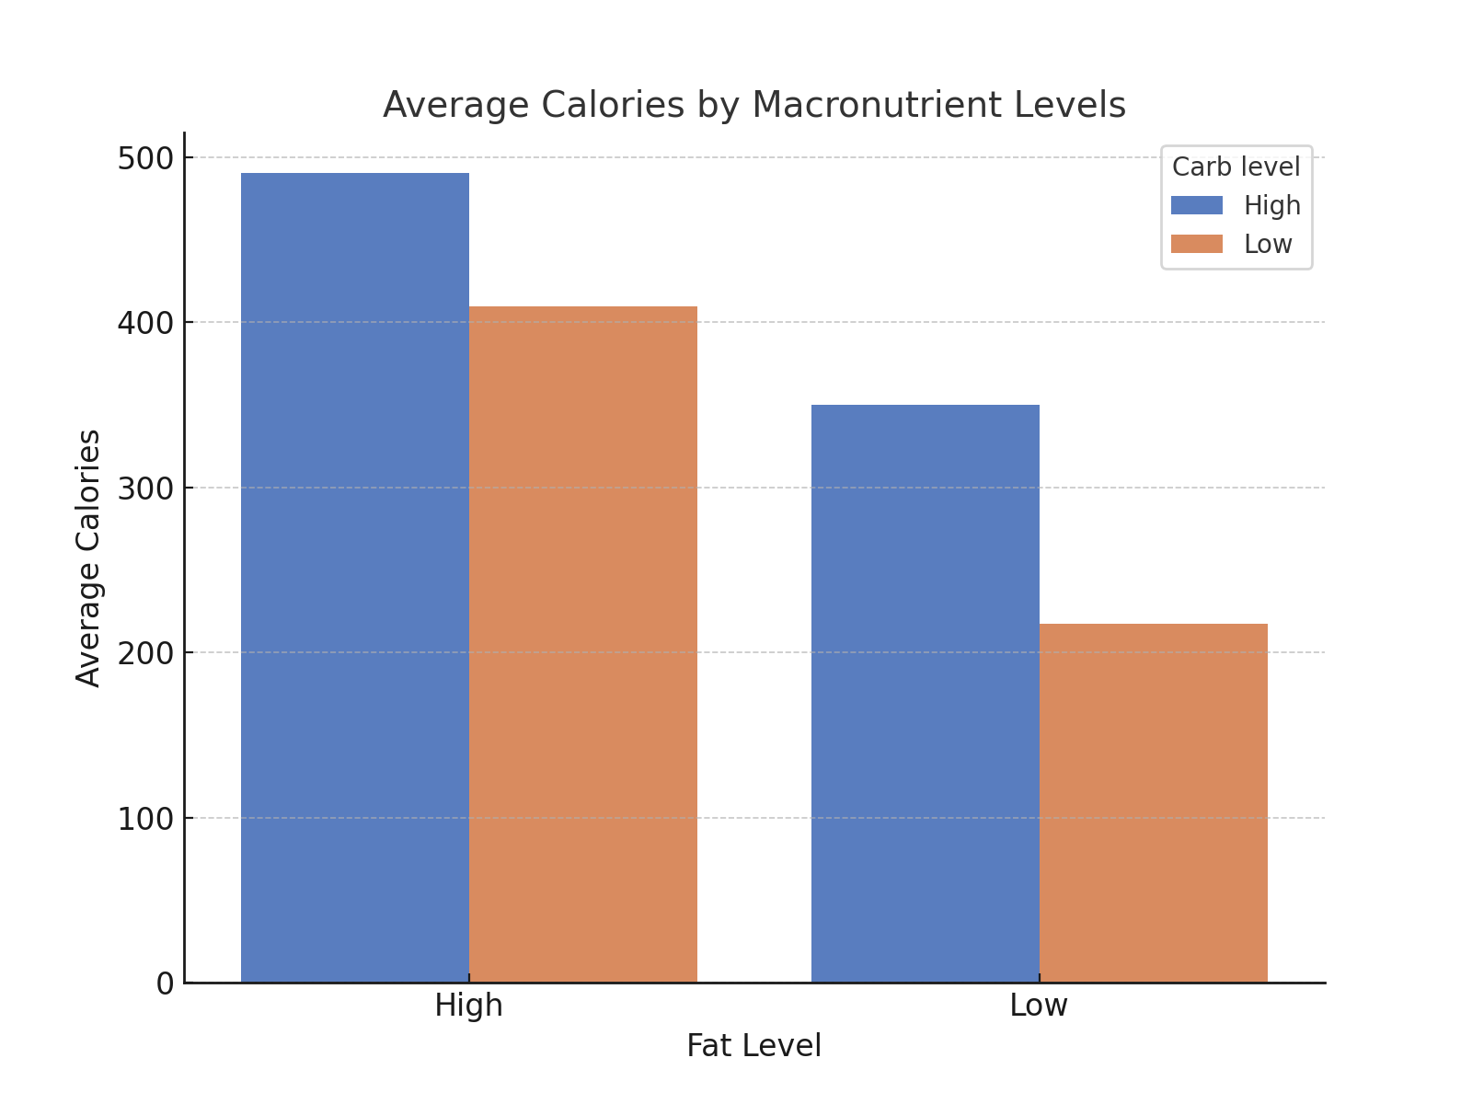
Average Calories by Macronutrient Levels
This bar chart compares average calories based on two macronutrient levels. Fat Level and Carb Level.
Items with high fat and high carb levels have the highest average calories.
Items with low fat and low carb levels have the lowest average calories.

Slide 11
Insights
Correlation:
Calories have a noticeable positive correlation with fat and carbs.
Distribution:
The majority of items have moderate calorie content, with a few high-calorie items.
Trends:
Items with high fat or high carbs tend to have higher calorie values.
The histograms suggest that foods with high fat and carbs are the most calorie-dense.

Slide 12
Conclusion
This analysis reveals several key insights into the nutritional content of Starbucks menu items. The correlation between calories and fat, carbs, and protein can guide menu optimization strategies. Further investigation could explore the impact of specific food categories on overall calorie content.

